Slide 1

Rockbuster Stealth LLC
Sales Analysis
May 2023

Slide 2
Agenda
Introduction
Research Findings
Recommendation

Slide 3
Rockbuster Stealth LLC introduction
Rockbuster Stealth LLC is a movie rental company that used to have stores around the world. Facing stiff competition from streaming services such as Netflix and Amazon Prime, the Rockbuster Stealth management team is planning to use its existing movie licences to launch an online video rental service in order to stay competitive. • Objective: To help the business intelligence (BI) department with the launch strategy for the new online video service
Objective: To help the business intelligence (BI) department with the launch strategy for the new online video service.

Slide 4
Data Overview
Number of Films: 1000
Number of Customers: 599
Most popular Genre: Sports
Number of countries: 109
Minimum rental duration: 3
Maximum rental duration: 7

Slide 5
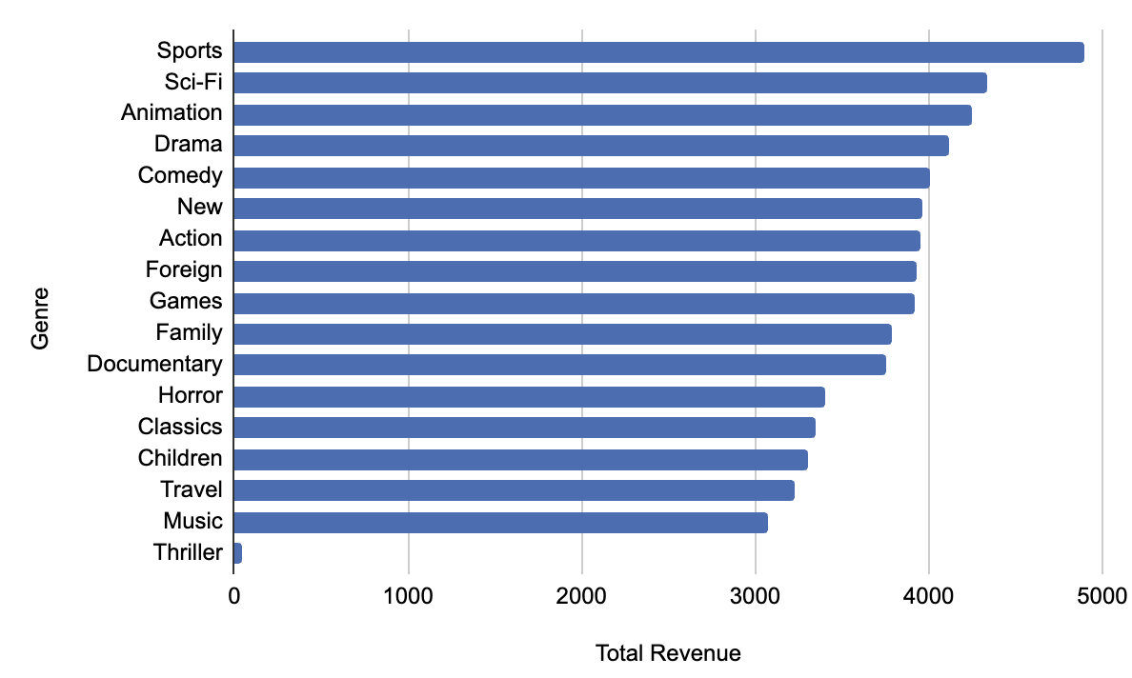
Revenue by Genre
Sports genre has the highest contribution to the overall revenue: $4892.19

Slide 6
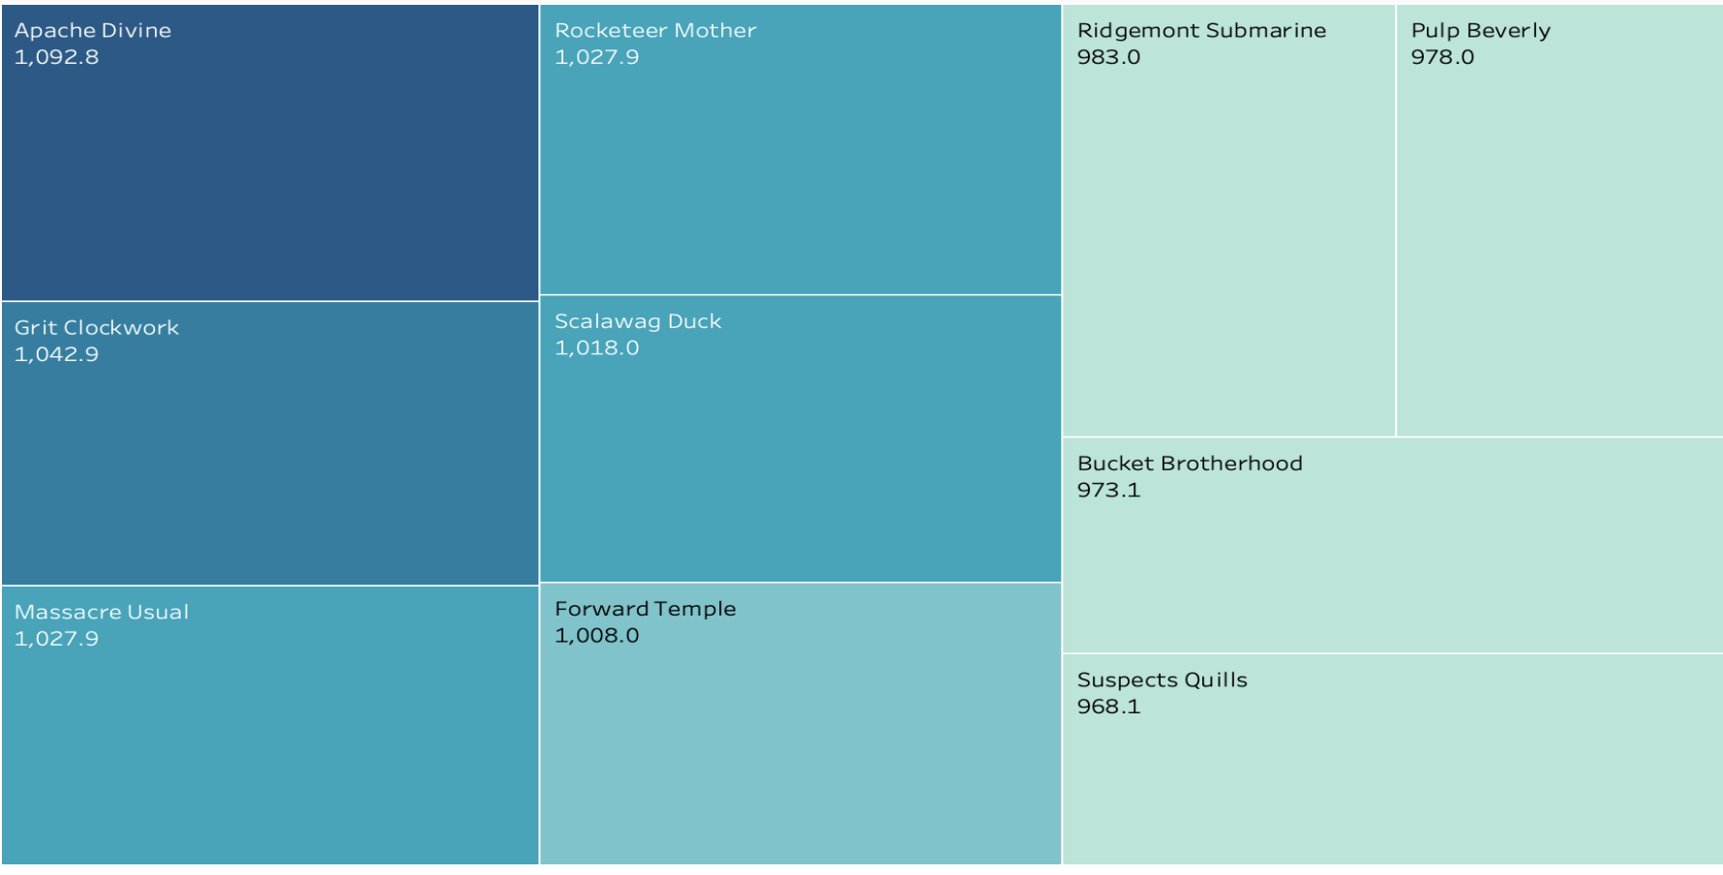
Revenu by Movie

Slide 7
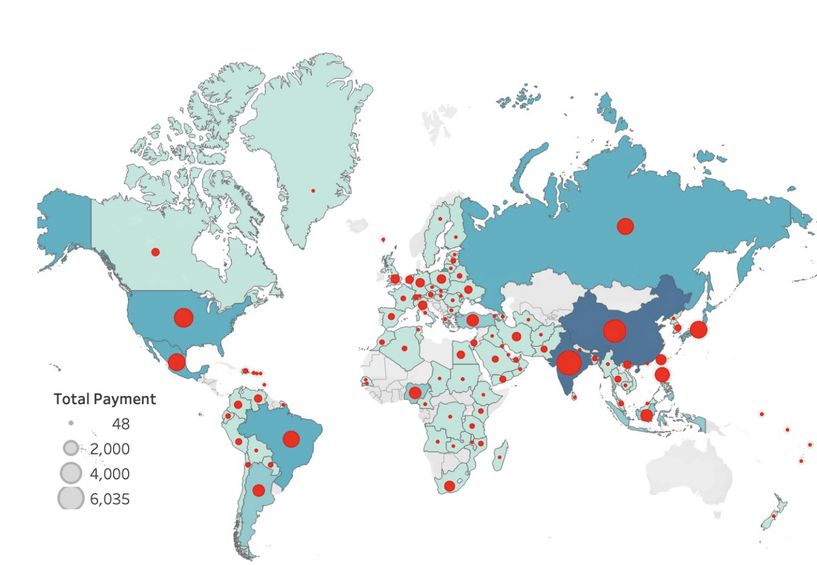
Country | Amount
India | $6,035
China | $5,251
United States | $3,681
Japan | $3.123
Mexico | $2,985
Brasil | $2,919
Russia | $2,766
Philippines | $2,220
Turkey | $1,498
Indonesia | $1,353
Sales by Country

Slide 8
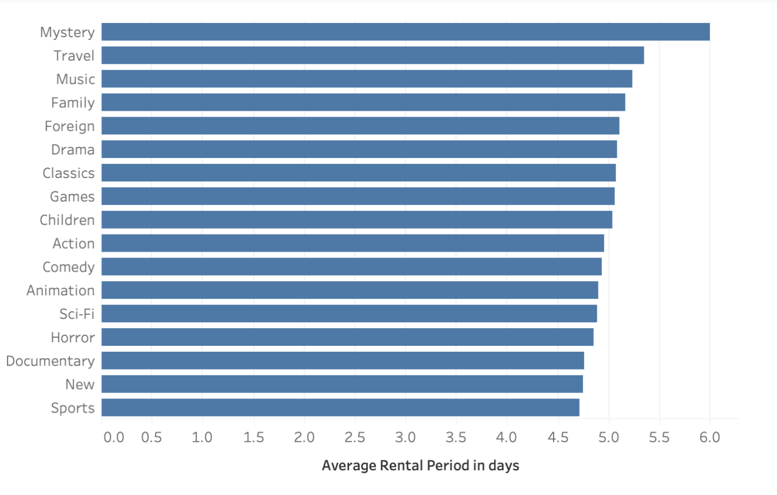
Highest average rental for Mystery genre is 6 days
Genre with the lowest rental average is Sports.
Average Rental Duration by Genre

Slide 9
Rockbuster Stealth LLC should prioritize titles with higher demands and revenue (India, China & USA) and may consider removing low revenue movies
Targeting market with high revenue generating genres: Sport, Sci-fi, Animation, Drama and Comedy
Implement loyalty programs for customers with the highest spend
Expand number of titles to reach more customers
Recommendations

